Slide 1

AFFORDABLE AND CLEAN ENERGY

Slide 2
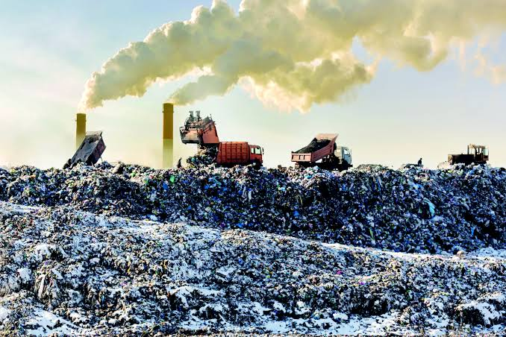
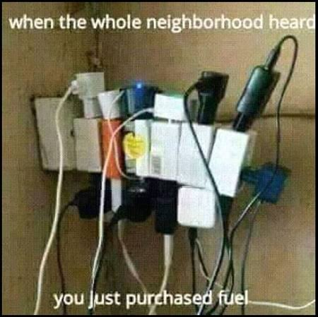
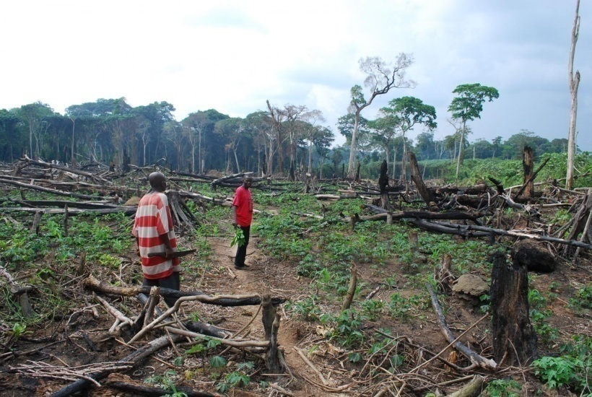
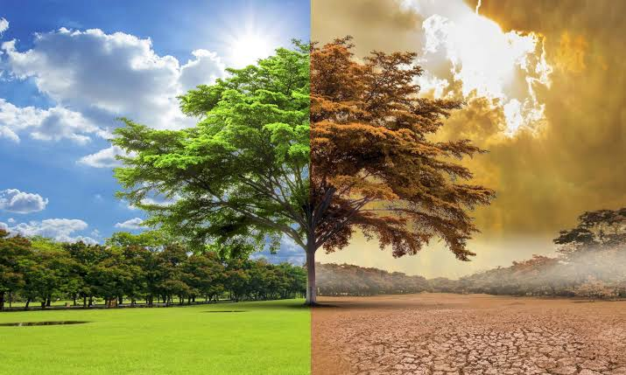
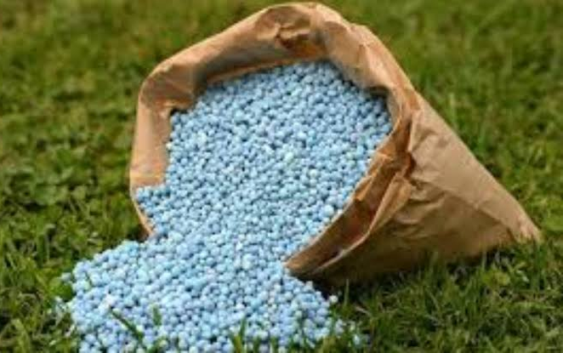
PROBLEMS
ENVIRONMENTAL
POLLUTION
DEFORESTATION
POWER SCARCITY
GLOBAL WARMING
USE OF CHEMICAL FERTILIZERS

Slide 3
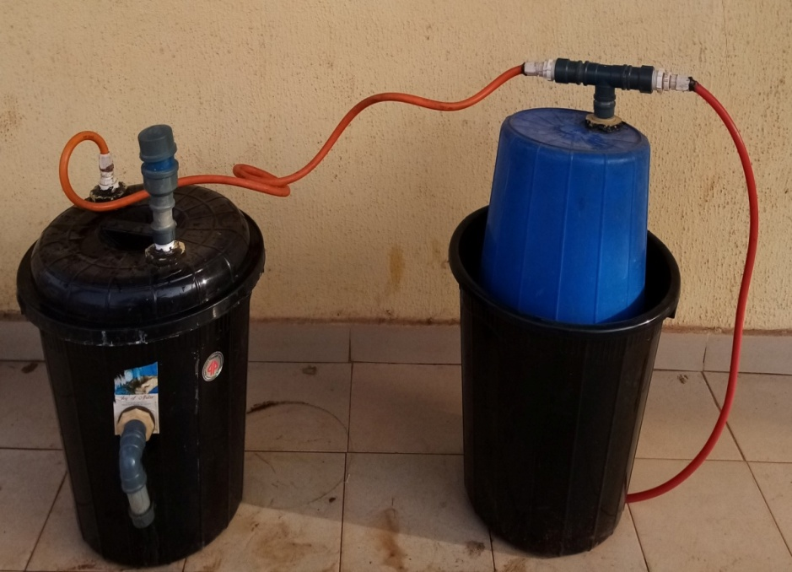
OUR SOLUTION
ECO-FRIENDLY
ENCOURAGES CIRCULAR ECONOMY
REDUCES ENVIRONMENTAL POLLUTION
PRODUCES ORGANIC FERTILIZERS
REDUCES
DEFORESTATION
HEALTHY COOKING ALTERNATIVE
CHEAPER ALTERNATIVE FOR GENERATING ELECTRICITY

Slide 4
MARKET ANALYSIS

Slide 5



COMPETITION AND UNIQUE VALUE PROPOSITION
Safer, affordable and readily available products to users
All petroleum related products, expensive and not easily accessible
OTHER ENERGY PROVIDERS
Works faster, unhealthy for crops
Commonly used, environmental pollution

Slide 6
TRACTION
Now we are currently in the prototyping and research stage. Where we have created a prototype and are now testing it to ensure it work the way it should at the University of Nigeria, Nsukka energy centre. But what limits us is funding for our research because we want expand our bio gas tank research by using more advanced materials.
So we are soliciting for funds to take our business to the next level.

Slide 7
REVENUE MODEL
Our subscription business model will generate revenue through the following;
Sales of the bio-recycler, biogas, bio-fertilizer and bio-waste.
Installation and maintenance services
Training and consultancy
Strong costumers (households, restaurants, hotels and farmers ).
Other potential costumers are schools, industries, the governments, non government organization (NGOs) and international donors/Development organizations

Slide 8

THE BIO-RECYCLER

Slide 9


TEAM
GLORY UCHECHI AMADIFE
MMERICHUKWU ANOSIKE NNAEBUKA
CO-FOUNDER
CO-FOUNDER

